Slide 1
Module11
Analytics & Views (first steps)

Slide 2
Views & Analytics
Objective:
Understanding the analytics use case
Understanding aggregations, denormalisations
Introduction to SQL Views

Slide 3
Analytics
Given data created by our app users, it may require further analysis
How will this be done?
Typically, people generate ‘reports’ by using SQL queries that select a subset of the data
For eg, in our users & articles modelling, we might need report for:
When did users sign up?
How many users have signed up?
How many articles have been written?
How many users have written more than one article?
What are the most popular categories and tags?
These analytics might be important for the organization developing the application
These analytics might be useful to add features to our application

Slide 4
Primary data vs data for analytics
In fact, data required for analytics does not actually need to be ‘stored’ since it’s already present in the data
Eg:
If the article_count table contains how many articles have been written by each author: Is an article count table necessary?
Then every time a new article is created or deleted, the article count table has to be updated transactionally!
However, the data for how many articles written by what user is already present in the article table!
Data required for analytics can just be derived from the primary ‘normalized’ data

Slide 5
Aggregations & Denormalizations
‘Aggregations’ are a common term used to describe the action of summarizing data from one or more tables primarily for statistical analysis
Eg: Article counts
‘Denormalizing’ is the term used to describe the action of taking normalized data from multiple normalized tables and putting them in one place for better analysis
Eg: Bringing together article, user_id, category, tags into one table for doing further analysis (typically aggregations);

Slide 6
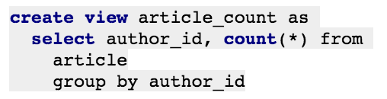
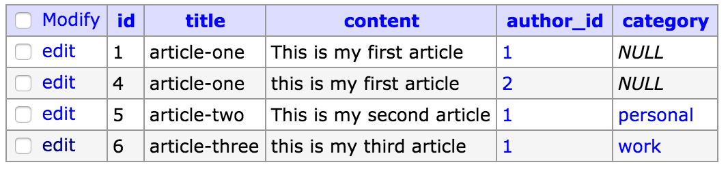
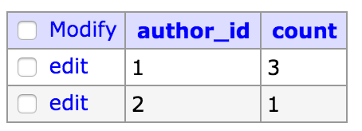
SQL Views
SQL Views are exactly like tables
However, these tables have been created by denormalizing and/or aggregating one or more existing tables
These ‘tables’ views, are not actually tables on disk. They are temporary tables that are actually computed whenever a query is made to select data from the ‘view’.
Eg:

Slide 7
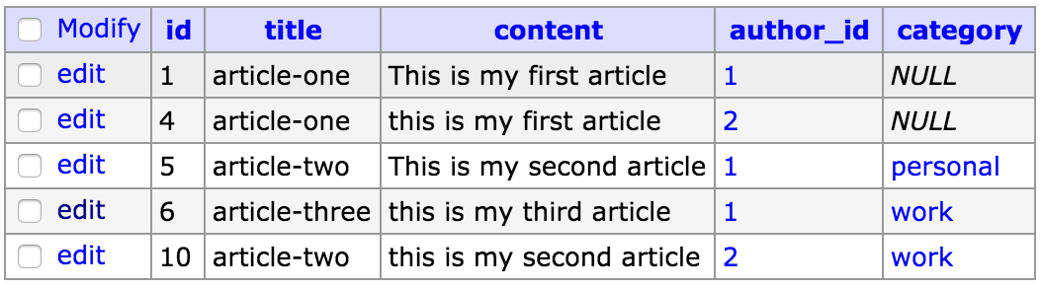
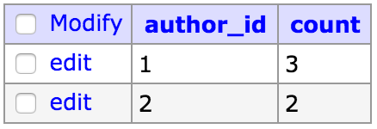
SQL Views
Any update to the primary table, is instantly reflected in the view

Slide 8
SQL Views
Advantages:
Derived data available as a table, without actually maintaining another table
Disadvantages:
Data not really on disk, needs to be computed every time.

Slide 9
SQL Views
The data that is primarily created is stored in a schema modelled for reducing unnecessary redundant data and for storing data with high-integrity. The process of modelling data to achieve higher levels of integrity and lower redundancy is called ‘normalization’.
However, data stored in that way might not be ideal for analytics
Data models required for analytics, that contain aggregate or denormalised data don’t necessarily need to be created and can just be derived from existing data as required realtime
However, if the load on the database is already very high then adding analytics queries to the mix is not a good idea.
In this case, data required for analytics can be ‘snapshotted’ or ‘materialized’ onto disk or stored in a different database altogether

Slide 10
Key takeaways
SQL is very useful for analytics
Aggregations on data represent statistical summaries of data
Denormalizations represent data from multiple data coming together from normalized forms into a more redundant view but better primed for analytics purposes
SQL views are very useful for creating ‘table’ like entities that are aggregations/denormalizations of existing tables (or views)

